Slide 1
Recipe Database Project
CIT225 Jandy Kiger

Slide 2
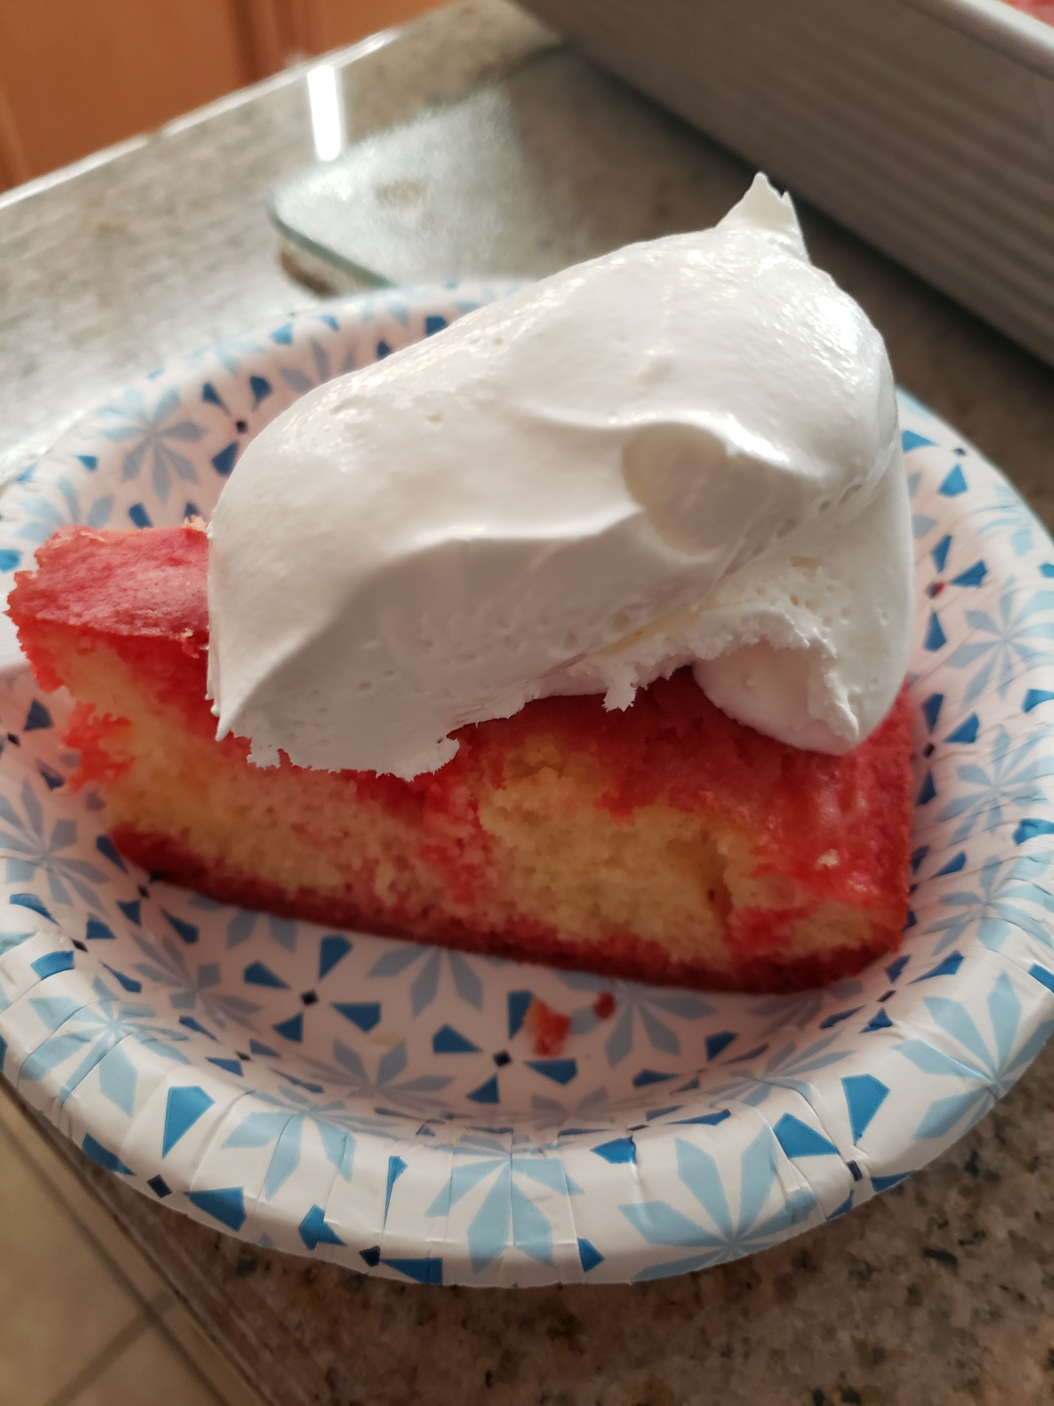


Recipe DB
My project is to create a database that would be able to keep my family’s recipes together and easily accessible.
Also, the ability to add to the database as new favorite recipes come in with new family members.
The specific tables are to help with being able to look up by different means. A meal with chicken as a key ingredient (key ingredient lookup).
Yorkshire Pudding
Jello Poke Cake
Braid Bread

Slide 3
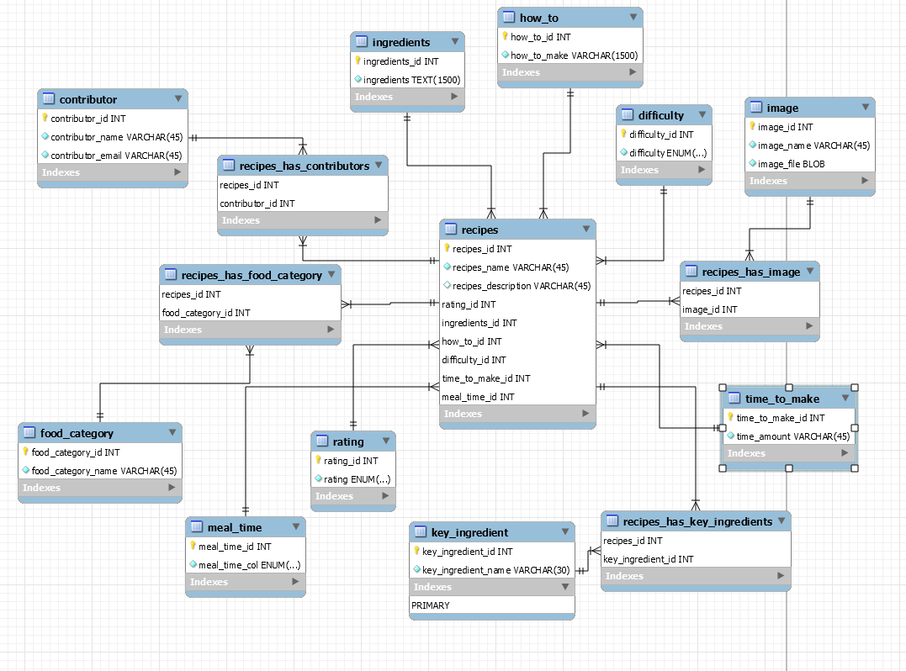
ERD

Slide 4
Using recipe database
In the background some of these searches are, (CRUD)
SELECT recipe_name
FROM recipe
WHERE recipe_name LIKE “%hamburger%”;
SELECT recipe_name, ingredient
FROM recipe r
INNER JOIN recipe_has_ingredients ri
ON r.recipe_id = ri.recipe_id
INNER JOIN ingredients i
ON ri.ingredients_id = i.ingredients_id
WHERE ingredient LIKE “%chicken%”;
SELECT recipe_name, category_name
FROM recipe r
INNER JOIN food_category c
ON r.recipe_id = c.recipe_id
WHERE category_name = ‘ENTREE’;
Find your next food project
Search by name
Search by ingredient
Search by category
Search by contributor
Search

Slide 5
Using recipe database
The plus sign will allow a recipe to be added to the database.
Each of these fields would have an insert statement to add the value to the table it belongs to.
Add your favorite recipe
Find your next food project
Recipe name
(CRUD)
INSERT INTO `recipes`.`key_ingredient`
(`key_ingredient_id`,
`key_ingredient_name`)
VALUES
(1,
'flour');
(CRUD)*
DELETE FROM `recipes`.`recipes`
WHERE recipes_id = 4
and recipes_name = 'Rice Pudding';
Meal Time
Search by name
Key Ingredient
Search by ingredient
Time to make
Search by category
Whose recipe
Difficulty
Search by contributor
Food category
*Although I don’t expect to use this delete statement (as these are tried and true recipes), this would need to be done on each of the affected tables (using key column to reference the correct item to drop).
Search
Rating
Save
Remove

Slide 6
Using recipe database
Each field that is required for the tables to be complete must be included.
The information that is required to be in specific data types should have a drop down choice.
Like food category, to minimize number of categories the data type is ENUM with specific choices for the recipe to fall in. (entree, salad, dessert, drink, sauce, breads, sides)
Should not be able to save without all fields entered
Add your favorite recipe
Find your next food project
Recipe name
Food Category
Search by name
Key Ingredient
Search by ingredient
Time to make
Search by category
Whose recipe
Difficulty
Search by contributor
Meal Time
Search
Rating
Save
Remove

Slide 7
Using recipe database
INSERT INTO `recipes`.`ingredients`
(`ingredients_id`,
`ingredients`)
VALUES
(1,
'10 1/2 cups bread flour
1/2 cup sugar
1 Tbsp salt
3 rounded Tbsp SAF instant yeast
3 quarter-sized drops of liquid lecithin
4 cups hot tap water - not too hot ');
INSERT INTO `recipes`.`how_to`
(`how_to_id`,
`how_to_make`)
VALUES
(1,
'Combine dry ingredients, (flour, sugar, salt, yeast).
Add lecithin and hot water to the dry ingredients and check for sticky consistency once all mixed in.
Mix/knead at medium speed for 5 minutes.
Remove from mixer and hand knead to remove any large air pockets.
Shape into loaves or rolls let rise 20 mins and bake at 350 for 18-25 minutes.');
What ingredients are needed for this recipe?
Directions:
Combine dry ingredients, (flour, sugar, salt, yeast).
Add lecithin and hot water to the dry ingredients and check for sticky consistency once all mixed in.
Mix/knead at medium speed for 5 minutes.
Remove from mixer and hand knead to remove any large air pockets.
Shape into loaves or rolls let rise 20 mins and bake at 350 for 18-25 minutes.
Ingredient list
Submit
Add more
Submit

Slide 8

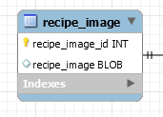
Using recipe database
INSERT INTO `recipes`.`image`
(`image_id`,
`image_name`,
`image_file`)
VALUES
(1,
'homemade bread',
'bread.jpg');
(CRUD)
UPDATE `recipes`.`image`
SET
`image_id` = 1,
`image_name` = ‘homemade braid bread’,
`image_file` = ‘braid.jpg’
WHERE `image_id` = 1;
Recipe Image:
Add Image

Slide 9
Making sense of the database with joins
select recipes_name, ingredients, how_to_make
from recipes r
join ingredients i
on r.ingredients_id = i.ingredients_id
join how_to h
on r.how_to_id = h.how_to_id
where recipes_name like ‘%Spud%’;
Find your next food project
Search by name
Search by key-ingredient
recipes_name ingredients how_to_make
Death Spuds 1 lb shredded hashbrowns
1/2 cup butter or margarine
1 cup sour cream
1 can cream of chicken soup
8-16 oz. grated cheese
Melt butter/margarine. Stir in soup and sour cream.
Pour over hashbrowns, mix well.
Stir in some of the cheese, if too dry add more sour cream.
Put in baking dish and sprinkle cheese over the top.
Bake at 350 for 30 or until heated through and cheese is melted.
Search by category
Search by contributor
Search

Slide 10
Insert linking tables
INSERT INTO `recipes`.`recipes_has_contributors`
(`recipes_id`,
`contributor_id`)
VALUES
(1, -- recipes_id
5), -- the contributor_id of the recipe
(2,
1),
(3,
5);
I found it helpful to keep notes of what was in each table to make it easy to reference for the linking tables.
Select * from contributor;
contributor_id contributor_name contributor_email
1 Jandy Kiger jandyrae@gmail.com
2 Jaquelle Dodge jaquelledodge@gmail.com
3 Marissa Perrett marissa.perrett@gmail.com
4 Michelle Higdon princesstigerlilly07@gmail.com
5 Jaynann Perrett jaynannperrett@gmail.com
select recipes_id, recipes_name Name from recipes;
recipes_id name
1 Death Spuds
2 Homemade Bread
3 Meatloaf

Slide 11
Create View to hide complexity of linking tables
create view general_vw (Recipe, Rating, Contributor, Category, Difficulty, Time )
as select rec.recipes_name,
case
when r.rating = 1 then 'Five Stars'
when r.rating = 2 then 'Four Stars'
when r.rating = 3 then 'Three Stars'
when r.rating = 4 then 'Two Stars'
else 'One Star'
end,
c.contributor_name, fc.food_category_name, d.difficulty, t.time_amount
from recipes rec
inner join rating r on rec.rating_id = r.rating_id
inner join recipes_has_contributors rc on rec.recipes_id = rc.recipes_id
inner join contributor c on rc.contributor_id = c.contributor_id
inner join recipes_has_food_category rfc on rec.recipes_id = rfc.recipes_id
inner join food_category fc on rfc.food_category_id = fc.food_category_id
inner join difficulty d on rec.difficulty_id = d.difficulty_id
inner join time_to_make t on rec.time_to_make_id = t.time_to_make_id;
select * from general_vw;
Recipe Rating Contributor Category Difficulty Time
Homemade Bread Five Stars Jandy Kiger Breads Comfortable 1 hour
Death Spuds Five Stars Jaynann Perrett Side Dishes Beginner 45 min
Meatloaf Five Stars Jaynann Perrett Main Dishes Beginner 45 min

Slide 12
Pitfalls
If I were to start this all over again, I would draw out the tables with some information in them. I found myself dropping and re-running adjusted scripts because I remembered an id for a table, but not a column that would make sense to the user (name). For example, I had a food_category_id, but missed the food_category_name, often little things I figured out once I had data to enter.
I still think there will be a problem with key_ingredients as it leaves so much to user discretion, and spelling errors could create new rows and lost ability to query. I think a search of the ingredient field may be more effective in finding data, but the cost could be that it takes longer than an indexed key_ingredient table.
I have entered data and used queries to verify it is all where it needs to be, so it is very cool to see it working! I am positive there are improvements to be made but I am excited to be able to use what I have learned this semester.

Slide 13
Script to run the Recipes Database
-- -----------------------------------------------------
-- Schema recipes
-- -----------------------------------------------------
-- Final Project CIT225
DROP SCHEMA IF EXISTS `recipes` ;
-- -----------------------------------------------------
-- Schema recipes
--
-- Final Project CIT225
-- -----------------------------------------------------
CREATE SCHEMA IF NOT EXISTS `recipes` DEFAULT CHARACTER SET utf8 COLLATE utf8_bin ;
USE `recipes` ;
-- -----------------------------------------------------
-- Table `recipes`.`rating`
-- -----------------------------------------------------
DROP TABLE IF EXISTS `recipes`.`rating` ;
CREATE TABLE IF NOT EXISTS `recipes`.`rating` (
`rating_id` INT NOT NULL AUTO_INCREMENT,
`rating` ENUM('5', '4', '3', '2', '1') NOT NULL,
PRIMARY KEY (`rating_id`))
ENGINE = InnoDB;
-- -----------------------------------------------------
-- Table `recipes`.`ingredients`
-- -----------------------------------------------------
DROP TABLE IF EXISTS `recipes`.`ingredients` ;
CREATE TABLE IF NOT EXISTS `recipes`.`ingredients` (
`ingredients_id` INT NOT NULL AUTO_INCREMENT,
`ingredients` TEXT(1500) NOT NULL,
PRIMARY KEY (`ingredients_id`))
ENGINE = InnoDB;

Slide 14
-- -----------------------------------------------------
-- Table `recipes`.`how_to`
-- -----------------------------------------------------
DROP TABLE IF EXISTS `recipes`.`how_to` ;
CREATE TABLE IF NOT EXISTS `recipes`.`how_to` (
`how_to_id` INT NOT NULL AUTO_INCREMENT,
`how_to_make` VARCHAR(1500) NOT NULL,
PRIMARY KEY (`how_to_id`))
ENGINE = InnoDB;
-- -----------------------------------------------------
-- Table `recipes`.`difficulty`
-- -----------------------------------------------------
DROP TABLE IF EXISTS `recipes`.`difficulty` ;
CREATE TABLE IF NOT EXISTS `recipes`.`difficulty` (
`difficulty_id` INT NOT NULL AUTO_INCREMENT,
`difficulty` ENUM('Expert', 'Comfortable', 'Beginner', 'Children') NOT NULL,
PRIMARY KEY (`difficulty_id`))
ENGINE = InnoDB;
-- -----------------------------------------------------
-- Table `recipes`.`time_to_make`
-- -----------------------------------------------------
DROP TABLE IF EXISTS `recipes`.`time_to_make` ;
CREATE TABLE IF NOT EXISTS `recipes`.`time_to_make` (
`time_to_make_id` INT NOT NULL AUTO_INCREMENT,
`time_amount` VARCHAR(45) NOT NULL,
PRIMARY KEY (`time_to_make_id`))
ENGINE = InnoDB;
-- -----------------------------------------------------
-- Table `recipes`.`meal_time`
-- -----------------------------------------------------
DROP TABLE IF EXISTS `recipes`.`meal_time` ;
CREATE TABLE IF NOT EXISTS `recipes`.`meal_time` (
`meal_time_id` INT NOT NULL AUTO_INCREMENT,
`meal_time_col` ENUM('Breakfast', 'Lunch', 'Dinner', 'Any') NOT NULL,
PRIMARY KEY (`meal_time_id`))
ENGINE = InnoDB;

Slide 15
-- -----------------------------------------------------
-- Table `recipes`.`recipes`
-- -----------------------------------------------------
DROP TABLE IF EXISTS `recipes`.`recipes` ;
CREATE TABLE IF NOT EXISTS `recipes`.`recipes` (
`recipes_id` INT NOT NULL AUTO_INCREMENT,
`recipes_name` VARCHAR(45) NOT NULL,
`recipes_description` VARCHAR(45) NULL,
`rating_id` INT NOT NULL,
`ingredients_id` INT NOT NULL,
`how_to_id` INT NOT NULL,
`difficulty_id` INT NOT NULL,
`time_to_make_id` INT NOT NULL,
`meal_time_id` INT NOT NULL,
PRIMARY KEY (`recipes_id`, `rating_id`, `ingredients_id`, `how_to_id`, `difficulty_id`, `time_to_make_id`, `meal_time_id`),
INDEX `fk_recipes_rating1_idx` (`rating_id` ASC) VISIBLE,
INDEX `fk_recipes_ingredients1_idx` (`ingredients_id` ASC) VISIBLE,
INDEX `fk_recipes_how_to1_idx` (`how_to_id` ASC) VISIBLE,
INDEX `fk_recipes_difficulty1_idx` (`difficulty_id` ASC) VISIBLE,
INDEX `fk_recipes_time_to_make1_idx` (`time_to_make_id` ASC) VISIBLE,
INDEX `fk_recipes_meal_time1_idx` (`meal_time_id` ASC) VISIBLE,
CONSTRAINT `fk_recipes_rating1`
FOREIGN KEY (`rating_id`)
REFERENCES `recipes`.`rating` (`rating_id`)
ON DELETE NO ACTION
ON UPDATE NO ACTION,
CONSTRAINT `fk_recipes_ingredients1`
FOREIGN KEY (`ingredients_id`)
REFERENCES `recipes`.`ingredients` (`ingredients_id`)
ON DELETE NO ACTION
ON UPDATE NO ACTION,
CONSTRAINT `fk_recipes_how_to1`
FOREIGN KEY (`how_to_id`)
REFERENCES `recipes`.`how_to` (`how_to_id`)
ON DELETE NO ACTION
ON UPDATE NO ACTION,
CONSTRAINT `fk_recipes_difficulty1`
FOREIGN KEY (`difficulty_id`)
REFERENCES `recipes`.`difficulty` (`difficulty_id`)
ON DELETE NO ACTION
ON UPDATE NO ACTION,
CONSTRAINT `fk_recipes_time_to_make1`
FOREIGN KEY (`time_to_make_id`)
REFERENCES `recipes`.`time_to_make` (`time_to_make_id`)
ON DELETE NO ACTION
ON UPDATE NO ACTION,
CONSTRAINT `fk_recipes_meal_time1`
FOREIGN KEY (`meal_time_id`)
REFERENCES `recipes`.`meal_time` (`meal_time_id`)
ON DELETE NO ACTION
ON UPDATE NO ACTION)
ENGINE = InnoDB;

Slide 16
-- -----------------------------------------------------
-- Table `recipes`.`contributor`
-- -----------------------------------------------------
DROP TABLE IF EXISTS `recipes`.`contributor` ;
CREATE TABLE IF NOT EXISTS `recipes`.`contributor` (
`contributor_id` INT NOT NULL AUTO_INCREMENT,
`contributor_name` VARCHAR(45) NOT NULL,
`contributor_email` VARCHAR(45) NOT NULL,
PRIMARY KEY (`contributor_id`))
ENGINE = InnoDB;
-- -----------------------------------------------------
-- Table `recipes`.`food_category`
-- -----------------------------------------------------
DROP TABLE IF EXISTS `recipes`.`food_category` ;
CREATE TABLE IF NOT EXISTS `recipes`.`food_category` (
`food_category_id` INT NOT NULL AUTO_INCREMENT,
`food_category_name` VARCHAR(45) NOT NULL,
PRIMARY KEY (`food_category_id`))
ENGINE = InnoDB;
-- -----------------------------------------------------
-- Table `recipes`.`image`
-- -----------------------------------------------------
DROP TABLE IF EXISTS `recipes`.`image` ;
CREATE TABLE IF NOT EXISTS `recipes`.`image` (
`image_id` INT NOT NULL AUTO_INCREMENT,
`image_name` VARCHAR(45) NOT NULL,
`image_file` BLOB NOT NULL,
PRIMARY KEY (`image_id`))
ENGINE = InnoDB;
-- -----------------------------------------------------
-- Table `recipes`.`key_ingredient`
-- -----------------------------------------------------
DROP TABLE IF EXISTS `recipes`.`key_ingredient` ;
CREATE TABLE IF NOT EXISTS `recipes`.`key_ingredient` (
`key_ingredient_id` INT NOT NULL AUTO_INCREMENT,
`key_ingredient_name` VARCHAR(30) NOT NULL,
PRIMARY KEY (`key_ingredient_id`))
ENGINE = InnoDB;

Slide 17
-- -----------------------------------------------------
-- Table `recipes`.`recipes_has_contributors`
-- -----------------------------------------------------
DROP TABLE IF EXISTS `recipes`.`recipes_has_contributors` ;
CREATE TABLE IF NOT EXISTS `recipes`.`recipes_has_contributors` (
`recipes_id` INT NOT NULL,
`contributor_id` INT NOT NULL,
PRIMARY KEY (`recipes_id`, `contributor_id`),
INDEX `fk_recipes_has_contributor_contributor1_idx` (`contributor_id` ASC) VISIBLE,
INDEX `fk_recipes_has_contributor_recipes_idx` (`recipes_id` ASC) VISIBLE,
CONSTRAINT `fk_recipes_has_contributor_recipes`
FOREIGN KEY (`recipes_id`)
REFERENCES `recipes`.`recipes` (`recipes_id`)
ON DELETE NO ACTION
ON UPDATE NO ACTION,
CONSTRAINT `fk_recipes_has_contributor_contributor1`
FOREIGN KEY (`contributor_id`)
REFERENCES `recipes`.`contributor` (`contributor_id`)
ON DELETE NO ACTION
ON UPDATE NO ACTION)
ENGINE = InnoDB;
-- -----------------------------------------------------
-- Table `recipes`.`recipes_has_food_category`
-- -----------------------------------------------------
DROP TABLE IF EXISTS `recipes`.`recipes_has_food_category` ;
CREATE TABLE IF NOT EXISTS `recipes`.`recipes_has_food_category` (
`recipes_id` INT NOT NULL,
`food_category_id` INT NOT NULL,
PRIMARY KEY (`recipes_id`, `food_category_id`),
INDEX `fk_recipes_has_food_category_food_category1_idx` (`food_category_id` ASC) VISIBLE,
INDEX `fk_recipes_has_food_category_recipes1_idx` (`recipes_id` ASC) VISIBLE,
CONSTRAINT `fk_recipes_has_food_category_recipes1`
FOREIGN KEY (`recipes_id`)
REFERENCES `recipes`.`recipes` (`recipes_id`)
ON DELETE NO ACTION
ON UPDATE NO ACTION,
CONSTRAINT `fk_recipes_has_food_category_food_category1`
FOREIGN KEY (`food_category_id`)
REFERENCES `recipes`.`food_category` (`food_category_id`)
ON DELETE NO ACTION
ON UPDATE NO ACTION)
ENGINE = InnoDB;

Slide 18
-- -----------------------------------------------------
-- Table `recipes`.`recipes_has_image`
-- -----------------------------------------------------
DROP TABLE IF EXISTS `recipes`.`recipes_has_image` ;
CREATE TABLE IF NOT EXISTS `recipes`.`recipes_has_image` (
`recipes_id` INT NOT NULL,
`image_id` INT NOT NULL,
PRIMARY KEY (`recipes_id`, `image_id`),
INDEX `fk_recipes_has_image_image1_idx` (`image_id` ASC) VISIBLE,
INDEX `fk_recipes_has_image_recipes1_idx` (`recipes_id` ASC) VISIBLE,
CONSTRAINT `fk_recipes_has_image_recipes1`
FOREIGN KEY (`recipes_id`)
REFERENCES `recipes`.`recipes` (`recipes_id`)
ON DELETE NO ACTION
ON UPDATE NO ACTION,
CONSTRAINT `fk_recipes_has_image_image1`
FOREIGN KEY (`image_id`)
REFERENCES `recipes`.`image` (`image_id`)
ON DELETE NO ACTION
ON UPDATE NO ACTION)
ENGINE = InnoDB;
-- -----------------------------------------------------
-- Table `recipes`.`recipes_has_key_ingredients`
-- -----------------------------------------------------
DROP TABLE IF EXISTS `recipes`.`recipes_has_key_ingredients` ;
CREATE TABLE IF NOT EXISTS `recipes`.`recipes_has_key_ingredients` (
`recipes_id` INT NOT NULL,
`key_ingredient_id` INT NOT NULL,
PRIMARY KEY (`recipes_id`, `key_ingredient_id`),
INDEX `fk_recipes_has_key_ingredient_key_ingredient1_idx` (`key_ingredient_id` ASC) VISIBLE,
INDEX `fk_recipes_has_key_ingredient_recipes1_idx` (`recipes_id` ASC) VISIBLE,
CONSTRAINT `fk_recipes_has_key_ingredient_recipes1`
FOREIGN KEY (`recipes_id`)
REFERENCES `recipes`.`recipes` (`recipes_id`)
ON DELETE NO ACTION
ON UPDATE NO ACTION,
CONSTRAINT `fk_recipes_has_key_ingredient_key_ingredient1`
FOREIGN KEY (`key_ingredient_id`)
REFERENCES `recipes`.`key_ingredient` (`key_ingredient_id`)
ON DELETE NO ACTION
ON UPDATE NO ACTION)
ENGINE = InnoDB;
-- --------------------------------------------------------------------- End of sql script for Recipes ----------------------------------------------------------------------

